Slide 1

Deadlock Detection and Recovery System
This presentation covers the development of a GUI-based system for detecting and recovering from deadlocks in operating systems. The system uses Banker's Algorithm principles to identify unsafe states and offers recovery options such as process termination and resource preemption. It serves as both a practical tool and an educational resource for understanding deadlock management.
Presented by: SAHIL (Reg No: 12322937, Roll No: 14), VISHAL SHUKLA (Reg No: 12306876, Roll No: 54), MOHAMMED SANAD K C (Reg No: 12325793, Roll No: 20). Submitted to Dr. Parvinder Singh for CSE316 Operating Systems.

Slide 2

What Is Deadlock?
Deadlock is a state in a process-resource system where processes are unable to proceed because each is waiting for resources held by others. This creates a cycle of dependencies that halts progress, causing the system to freeze or degrade performance.
Understanding deadlock is crucial in operating systems to ensure efficient resource allocation and system stability. Detecting deadlocks helps prevent system crashes and improves user experience.
Definition
Cause
Impact
A situation where processes wait indefinitely for resources held by each other.
Mutual resource holding and circular wait conditions among processes.
System halt or degraded performance due to resource contention.

Slide 3

How to Handle Deadlock
Deadlock handling involves detecting unsafe states and recovering the system to a safe state. The system applies a safe sequence check similar to Banker's Algorithm to detect deadlocks.
Once detected, recovery options include terminating a process or preempting resources from a process. These strategies help break the deadlock cycle and restore normal system operation.
Detection
Termination
Check if a safe sequence exists to determine deadlock presence.
Remove a process to free resources and resolve deadlock.
Preemption
Reclaim resources from a process to break the deadlock cycle.

Slide 4
How to Avoid Deadlock
Deadlock avoidance requires careful resource allocation to maintain system safety. The system uses the Banker's Algorithm principle to ensure resources are allocated only if the system remains in a safe state.
This proactive approach prevents circular wait conditions by checking resource availability against process needs before allocation, thus avoiding deadlocks before they occur.
Safe State
Unsafe State
Resources are allocated only if all processes can complete without deadlock.
Resource allocation may lead to deadlock; system must avoid this state.

Slide 5
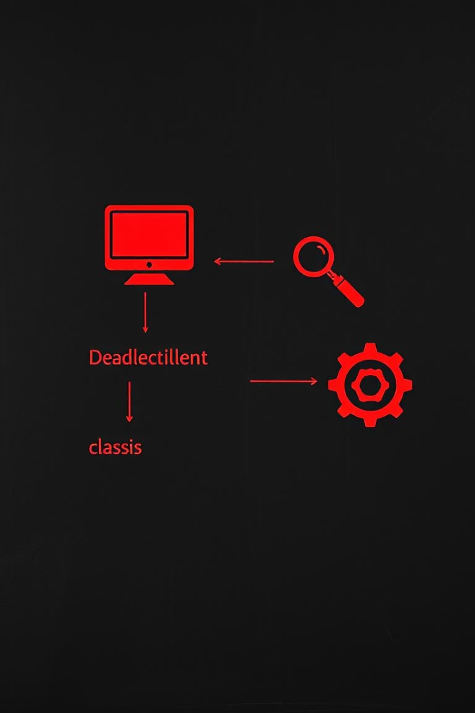
System Design Overview
The system consists of three main components: Process Class, DeadlockDetector Class, and DeadlockApp Class. The Process Class models individual processes and their resource needs. The DeadlockDetector implements detection logic using safe sequence checks. The DeadlockApp provides a Tkinter GUI for user interaction.
This modular design allows clear separation of concerns and facilitates user-friendly deadlock management.
Process Class
DeadlockDetector Class
Manages process IDs, resource needs, allocations, and remaining needs.
Implements deadlock detection using safe sequence algorithms.
DeadlockApp Class
GUI interface for input, detection, and recovery operations.

Slide 6





System Workflow
The workflow begins with user input of total available resources and process details including maximum resource requirements. Upon triggering deadlock detection, the system applies a safe sequence check to determine if deadlock exists.
If a deadlock is detected, users can choose recovery options such as terminating a process or preempting resources. Otherwise, the system confirms a safe state and continues operation.
Input Resources & Processes
Deadlock Detection
No Deadlock
Deadlock Detected
Safe sequence exists
Recovery options shown

Slide 7
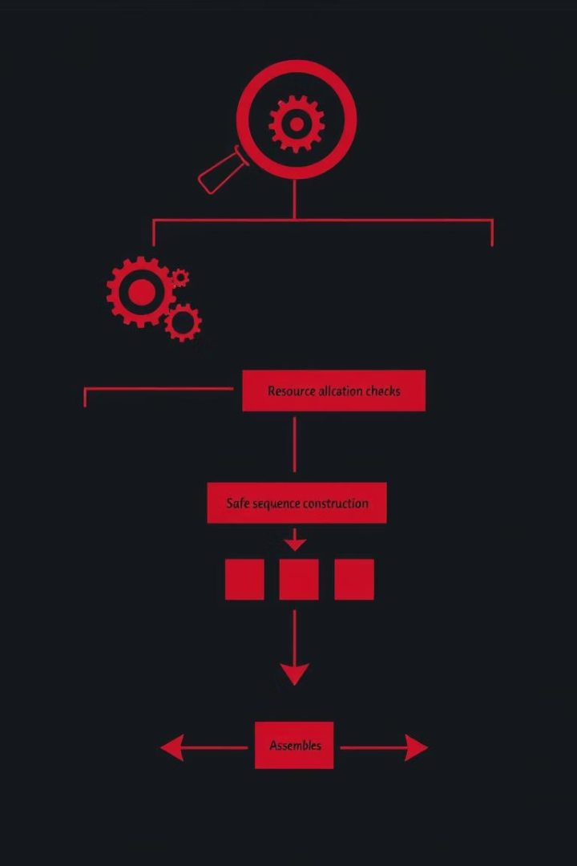
Deadlock Detection Algorithm
The detection algorithm uses an iterative approach to allocate resources to processes if their remaining needs can be met by currently available resources. It tracks which processes can finish and builds a safe sequence.
If all processes can finish, no deadlock exists. Otherwise, the system identifies a deadlock and returns an empty safe sequence.
Initialize Work and Finish
Set available resources and mark all processes unfinished.
Allocate Resources
Find processes whose needs can be met and simulate completion.
Check Completion
If all processes finish, system is safe; else deadlock detected.

Slide 8
Deadlock Recovery Strategies
When deadlock occurs, the system offers two recovery strategies: process termination and resource preemption. Termination removes a process to free its resources, while preemption selectively reclaims resources from a process.
These options help restore the system to a safe state, allowing other processes to continue execution and preventing system halt.
Process Termination
Resource Preemption
Remove a process to break the deadlock cycle and free resources.
Reclaim resources from a process to resolve deadlock without termination.

Slide 9

Flowchart of Deadlock Detection and Recovery
This flowchart illustrates the step-by-step process from user input to deadlock detection and recovery. It shows decision points for safe state checks and the options available when a deadlock is detected.
The flowchart helps visualize the system's logic and user interaction flow, enhancing understanding of deadlock management.
Step
Description
1
User inputs resources and processes
2
System performs deadlock detection
3
No deadlock: system continues
4
Deadlock detected: recovery options shown
5
User selects termination or preemption
6
System moves toward safe state

Slide 10

Conclusion and Future Enhancements
The Deadlock Detection and Recovery System effectively detects unsafe states and offers manual recovery options through a user-friendly GUI. It serves as both a practical solution and an educational tool for operating system resource management.
Future improvements include dynamic resource allocation, priority-based recovery, deadlock prediction, and distributed deadlock detection to enhance system capabilities and realism.
Dynamic Resource Allocation
Allow real-time updates to resource assignments during system operation.
Priority-Based Recovery
Select processes for termination or preemption based on priority levels.
Deadlock Prediction
Integrate analytics to forecast potential deadlocks before they occur.
Distributed Detection
Extend detection capabilities to distributed system environments.

